Slide 1
Computer Architecture & Assembly Language CSC-250
COURSE LECTURE
COMPUTER SCIENCE DEPARTMENT
SIBAU KANDHKOT CAMPUS

Slide 2
What is a program?
A sequence of steps
arithmetic or logical operation is done
a different set of
control signals is needed

Slide 3
Function of Control Unit
A unique code for each operation
Example: ADD, MOVE
Hardware Segment
Accept codes
Issues control signals

Slide 4
Computer Components
Computer
PC = Program Counter
IR = Instruction Register
MAR = Memory Address Register
MBR = Memory Buffer Register
I/O AR = Input/Output Address Register
I/O BR = Input/Output Buffer Register
Central Processing Unit (CPU)
PC
MAR
System
Bus
Main Memory
.
MBR
.
IR
.
0
1
2
.
.
.
I/O AR
Instruction
Execution Unit
Instruction
I/O BR
.
.
.
Data
I/O Module
Buffers
Data
.
.
.
.
.

Slide 5
Fetch Cycle
Program Counter (PC)
Holds address of next instruction to fetch
Processor
Fetch instruction from memory location pointed to by PC
Increment PC
Instruction Register (IR)
Load the instruction
Processor
Interprets instruction
Perform required actions

Slide 6
Execute Cycle
Processor I/O
Execution Cycle
Processor -Memory
Data Processing
Control

Slide 7
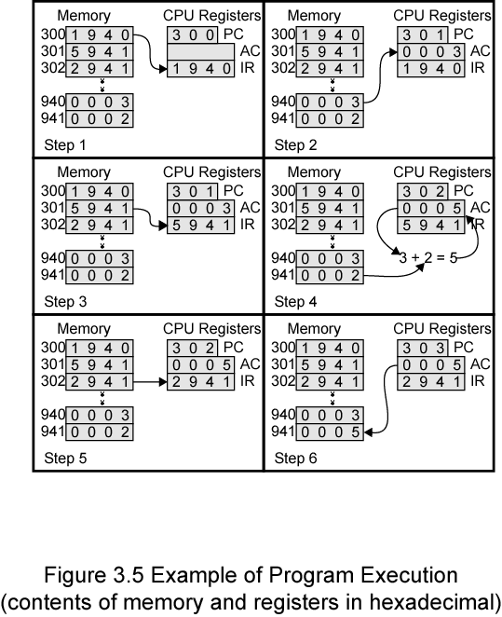
Addition Program Execution - Example

Slide 8
Instruction Cycle State Diagram
Instruction Fetch
Operand Fetch
Operand Store
Multiple Results
Multiple Operands
Instruction Address Calculation
Instruction Operation Decoding
Operand Address Calculation
Data Operation
Operand Address Calculation
Instruction complete, Fetch next instruction
Return for string or vector data

Slide 9
Interrupts
Mechanism by which other modules (e.g. I/O) may interrupt normal sequence of processing

Slide 10
Classes of Interrupts
Program
Stack overflow, division by zero
Timer
Generated by internal processor timer
Used in pre-emptive multi-tasking
I/O
I/O controller – signal the error condition
Hardware failure
Power failure

Slide 11
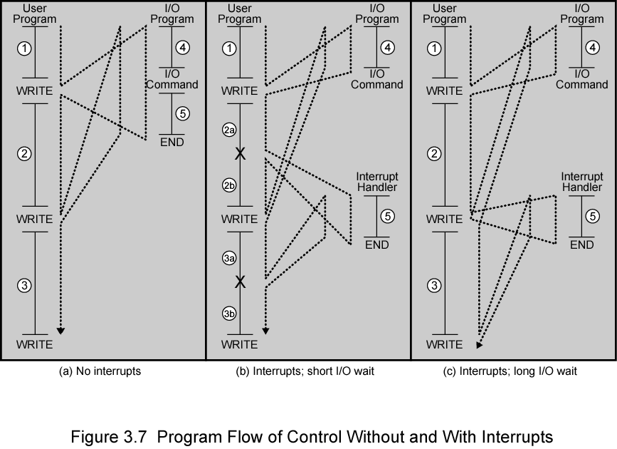
Interrupt – Program Flow Control

Slide 12
Interrupt Cycle
Added to instruction cycle
Fetch cycle
Execution cycle
Interrupt cycle
Interrupts disabled
Fetch Next Instruction
Execute Instruction
Check for interrupt; process interrupt
Start
Interrupts enabled
Halt

Slide 13
Interrupt Cycle (Cont.)
Processor checks for interrupt
Indicated by an interrupt signal
If no interrupt, fetch next instruction
If interrupt pending:
Suspend execution of current program
Save context
Set PC to start address of interrupt handler routine
Process interrupt
Restore context and continue interrupted program

Slide 14
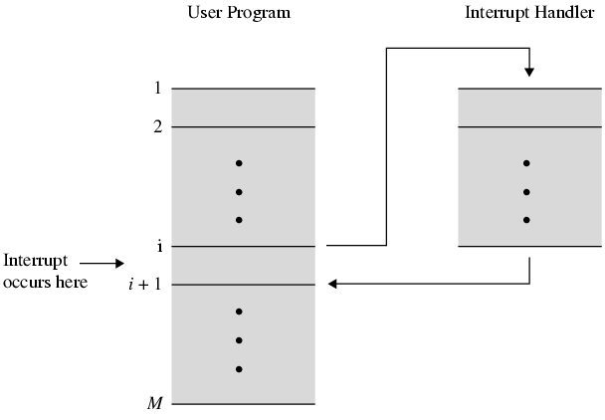
Transfer of Control via Interrupts

Slide 15
Multiple Interrupts - Approaches
Disable interrupts
Processor - ignore that interrupt request signal
Situation: executing the program and interrupt occurs – interrupts are disable immediately
Pending - checked after the processor has enabled interrupts
After interrupt handler routine completes
Enable interrupts before resume
Check additional interrupt
Handle interrupt in strict sequential order

Slide 16
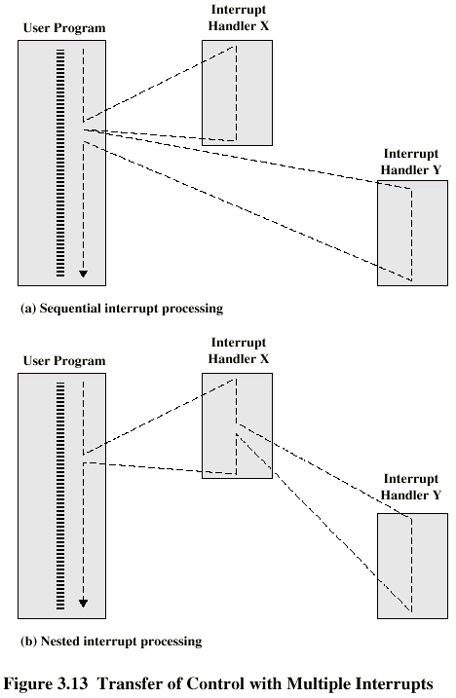
Multiple Interrupts – Sequential Interrupt Processing

Slide 17
Multiple Interrupts – Nested Interrupt Processing

Slide 18
Multiple Interrupts – Approaches (Cont.)
Define priorities
Low priority interrupts can be interrupted by higher priority interrupts
When higher priority interrupt has been processed, processor returns to previous interrupt

Slide 19
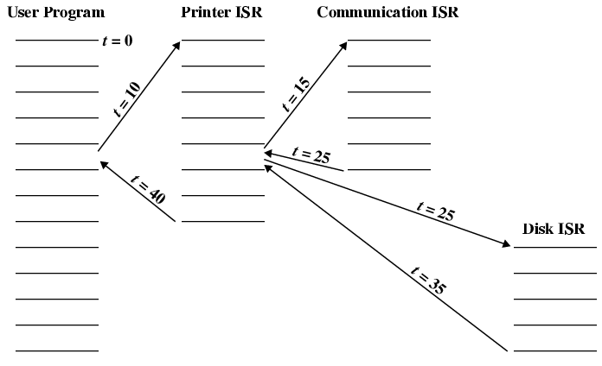
Time Sequence of Multiple Interrupts - Example

Slide 20
Interconnection Structures
Collection of paths connecting the various modules
Modules:
Memory
Processor
I/O module

Slide 21
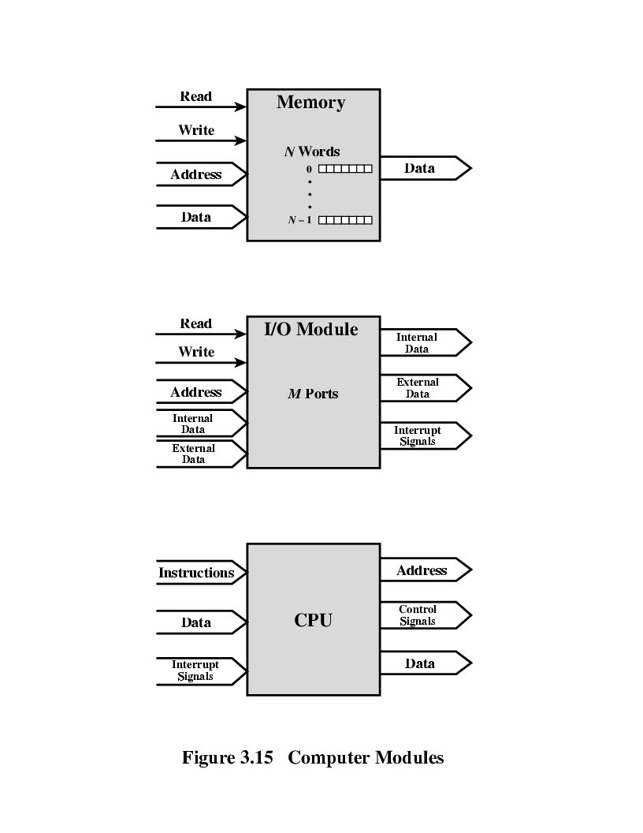
Modules: Major Form of Input and Output - Memory
Word of data - Read from or written into the memory
Assigned a unique numerical address
Nature of the operation – indicated by read and write control signals
Address – specify the location for the operation

Slide 22
Modules: Major Form of Input and Output - Processor
Reads instruction and data
Writes out data (after processing)
Sends control signals to other units
Receives (& acts on) interrupts

Slide 23
Modules: Major Form of Input and Output – I/O Module
Operations;
Read
Write
Control more than one external device
External data path – input and output of data
Send interrupt signals to CPU

Slide 24
Modules: Major Form of Input and Output

Slide 25
Types of Transfers
Memory to processor: Processor reads instruction/data from memory
Processor to memory: Processor writes data to memory
I/O to processor: Processor reads data from I/O device (via I/O module)
Processor to I/O: Processor sends data to I/O device
I/O to/from memory: allowed to exchange data using Direct Memory Access (DMA) – exclude processor

Slide 26
Bus Interconnection
Communication pathway connecting two or more devices
Key characteristic: shared transmission medium
Consists of multiple communication pathways/lines
Lines – transmit signals representing binary 1 and 0 – one data at a time

Slide 27
System Bus
A bus that connects major computer components (CPU, memory, I/O)
Computer interconnection structures – use one or more system buses
Consists of 50 to hundreds of separate lines
Each line – function. E.g: power

Slide 28
Data Line
Provide a path for moving data among system modules
Collective – data bus

Slide 29
Data Bus
Collective of data lines
Width of the data bus - Number of lines;
32, 64, 128 …
Key factor in determining overall system performance
Number of data lines – represents number of data can be transferred at a time

Slide 30
Address Lines
Designate the source or destination of the data on data bus

Slide 31
Address Bus
Collective of address lines
Width of the address bus determines the maximum possible memory capacity of the system

Slide 32
Control Lines
Used to control the access to and the use of the data and address lines
Control signals transmit both command and timing information among system modules
Command signals – specify operations to be performed
Timing signals – validity of data and address information

Slide 33
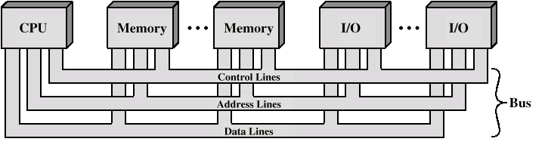
Bus Interconnection Scheme

Slide 34
Operation of the Bus
Send data
Obtain the use of the bus
Transfer data via the bus
Request data
Obtain the use of the bus
Transfer a request to the other module over appropriate control and address lines

Slide 35
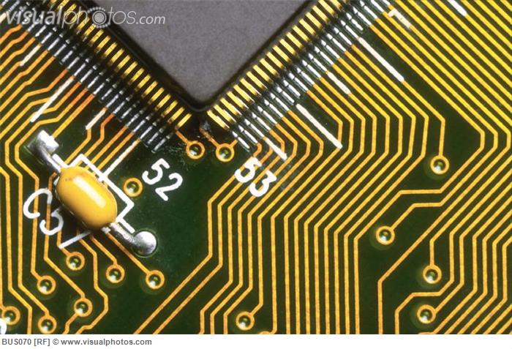
System Bus - Physical
Number of parallel electrical conductors – metal lines on the circuit board

Slide 36
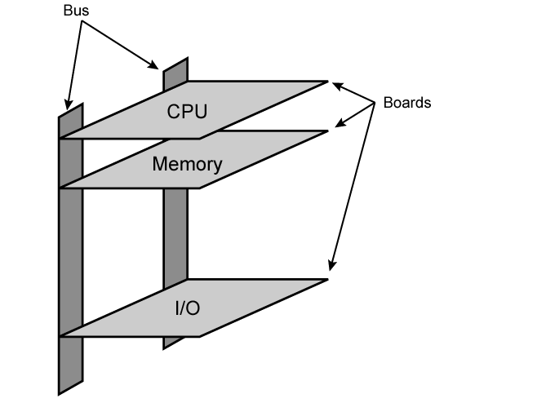
Physical Realization of Bus Architecture

Slide 37
Single Bus - Problem
Many of devices on one bus leads to:
Propagation delays
Long data paths mean that co-ordination of bus use can adversely affect performance
If aggregate data transfer approaches bus capacity
Most systems use multiple buses to overcome these problems

Slide 38
Types of Bus
Dedicated
Separate data & address lines
Multiplexed
Shared lines
Address valid or data valid control line
Advantage
Fewer lines
Disadvantages
More complex control
Reduction in performance

Slide 39
Bus Arbitration
Process of insuring only 1 devices places information onto the bus at a time
Master - slave mechanism
Master is given control of the bus and can place information onto it
Slave receives the information from the master
Two methods
Centralized
Decentralized

Slide 40
Master–Slave Mechanism: Methods
Centralized
Central bus controller mediates all device requests for the bus
May be part of CPU or a hardware of its own (arbiter)
Decentralized
No centralized controller
All devices contain logic to control access to the bus

Slide 41
Bus Timing
Synchronous
Occurrence of events on the bus is determined by the clock
All events start at the beginning of a clock cycle
Example: PCI bus (Peripheral Component Interface bus
Asynchronous
The occurrence of one event follows and depends on the occurrence of a previous event
More flexible than synchronous bus but more complicated as well
Accommodates wider range of device speeds
Example: Future bus+

Slide 42
Assignment for Reading
Traditional (ISA) VS High Performance Bus Structure

